Slide 1
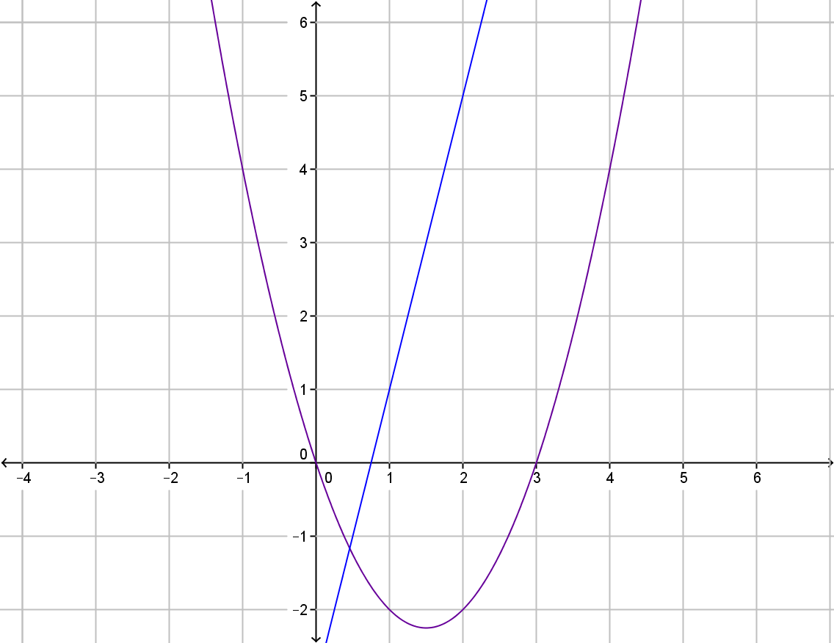
My Non-Linear Relationships Interactive Notebook
Name
Class
Term 4 Semester 2

Slide 2
Contents
Formula Page
Page
Date
Description
2
3

Slide 3
Tasks
24
7
30
Essential Question
Questions
Notes
Summary
4
5

Slide 4
24
7
30
Date
Quadratic Equations
EQ – Explain the process of drawing a quadratic graph.
5

Slide 5
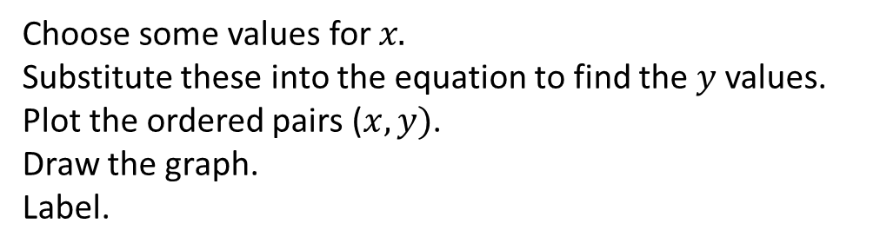
24
7
30
Date
Quadratic Graphs
EQ – Explain the process of drawing a quadratic graph.
Choose some values for $x.$
Substitute these into the equation to find the $y$ values.
Plot the ordered pairs ($x,y)$.
Draw the graph.
Label.
5

Slide 6
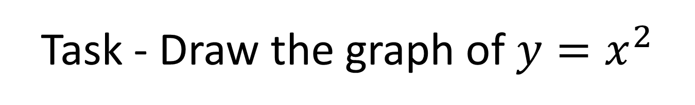
Task - Draw the graph of $y=x^{2}$

Slide 7
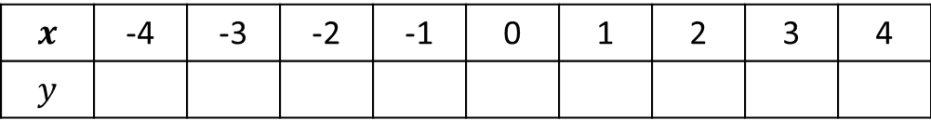
Task - Draw the graph of $y=x^{2}$
Copy and complete the table
$$x$$ | -4 | -3 | -2 | -1 | 0 | 1 | 2 | 3 | 4
$$y$$

Slide 8
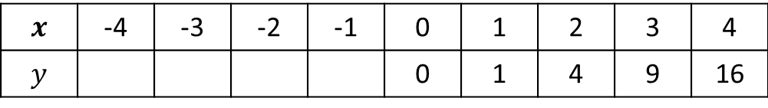
Task - Draw the graph of $y=x^{2}$
Copy and complete the table
$$x$$ | -4 | -3 | -2 | -1 | 0 | 1 | 2 | 3 | 4
$$y$$ |  |  |  |  | 0 | 1 | 4 | 9 | 16

Slide 9
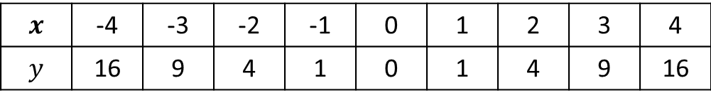
Task - Draw the graph of $y=x^{2}$
Copy and complete the table
$$x$$ | -4 | -3 | -2 | -1 | 0 | 1 | 2 | 3 | 4
$$y$$ | 16 | 9 | 4 | 1 | 0 | 1 | 4 | 9 | 16

Slide 10

Task - Draw the graph of $y=x^{2}$
Copy and complete the table
$$x$$ | -4 | -3 | -2 | -1 | 0 | 1 | 2 | 3 | 4
$$y$$ | 16 | 9 | 4 | 1 | 0 | 1 | 4 | 9 | 16
Draw a coordinate grid with $x$-values from -4 to 4.

Slide 11
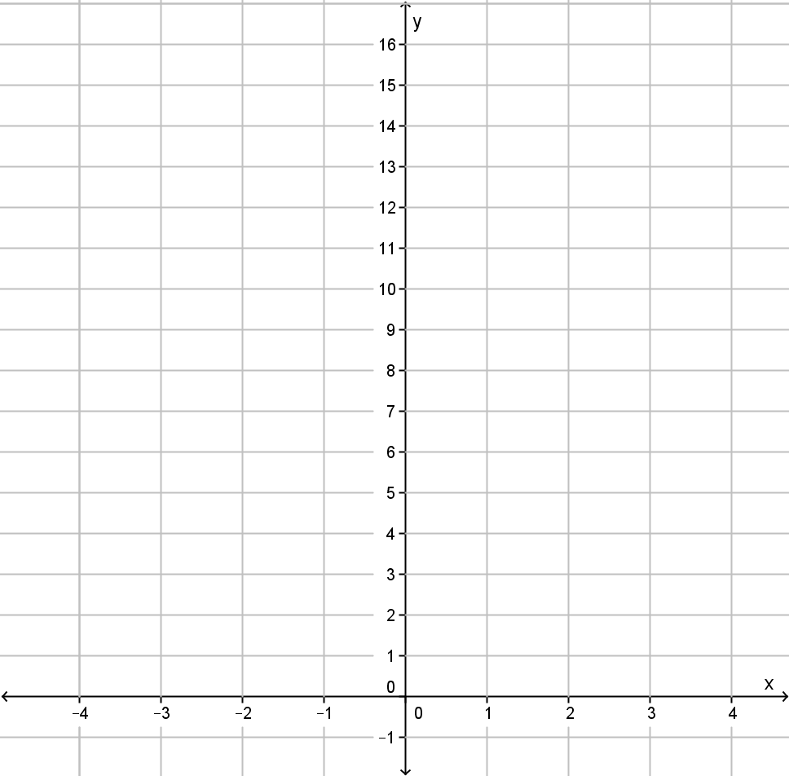

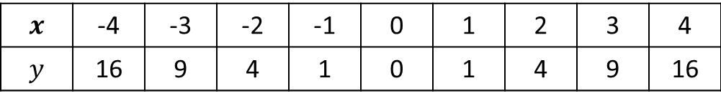
Task - Draw the graph of $y=x^{2}$
Copy and complete the table
$$x$$ | -4 | -3 | -2 | -1 | 0 | 1 | 2 | 3 | 4
$$y$$ | 16 | 9 | 4 | 1 | 0 | 1 | 4 | 9 | 16
Draw a coordinate grid with $x$-values from -4 to 4.

Slide 12
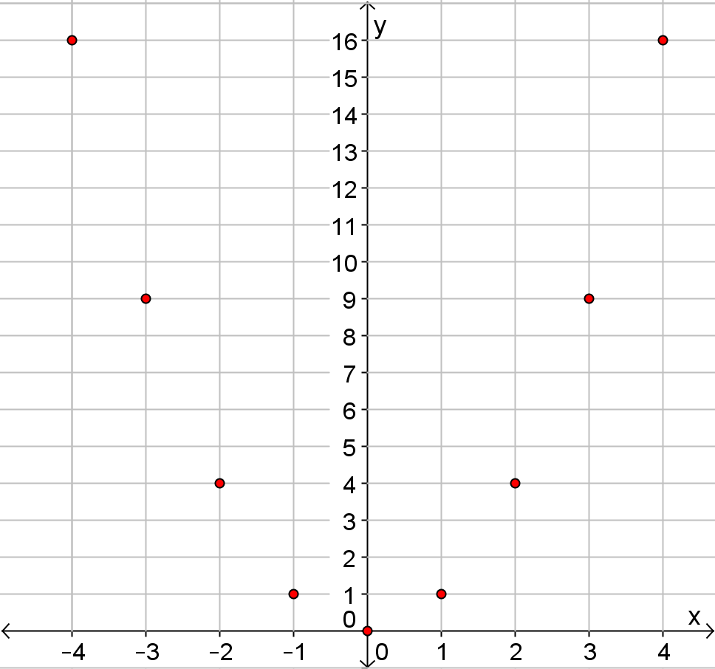

Slide 13
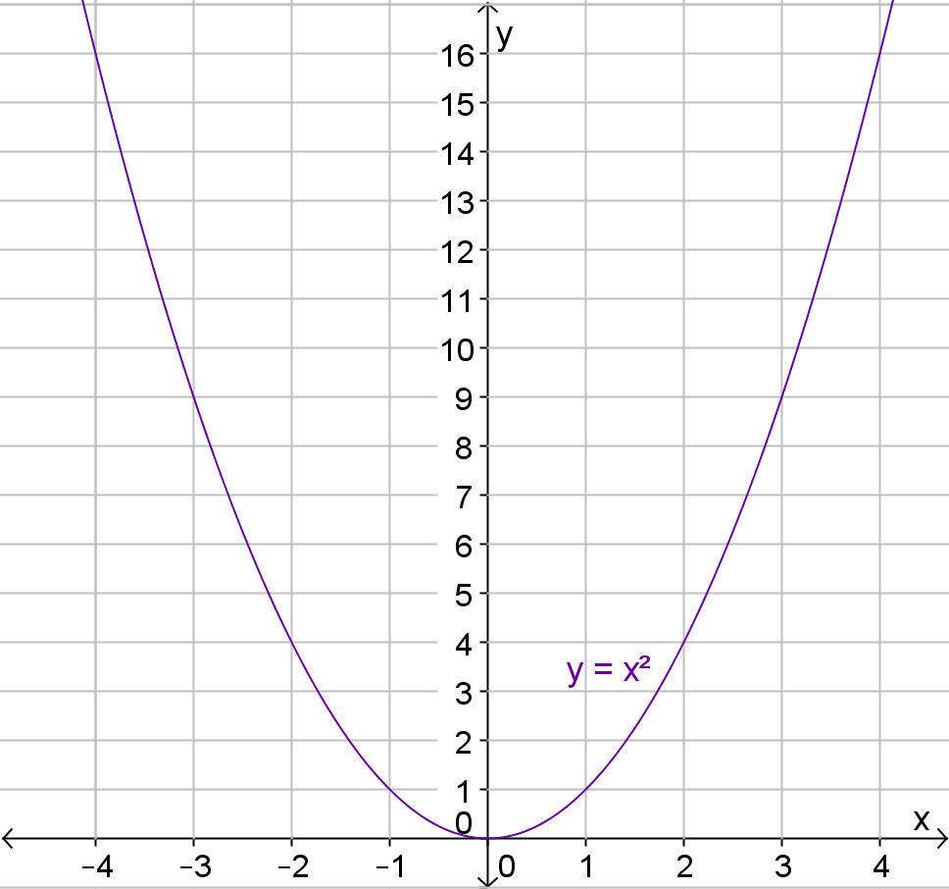

Slide 14
Questions

Slide 15
Notes Review
24, 7 ,30
Date
Title
Essential question
Notes complete
Notes complete with colour and diagrams
Questions completed
Contents page filed in
Formula page filled in

Slide 16
Homework
Review your notes and write a summary answering the essential question.

